Slide 1
SW Programming Project
#1. Problem Modeling

Slide 2
Topic
Implement a software system for
Searching for text files
Ranking the text files.
C:\>mysearch hello
a.txt
b.txt
C:\>
Notes:
우선 저는 이 토픽에 대해 엄청나게 혁신적이고 효과적인 단 하나의 기준을 세우는 것은 불가능하다고 여겼기 때문에, 기본적으로 여러 기준을 고려하여 각 기준마다의 가중치에 따라 랭킹 순서가 정해지게 하는 알고리즘을 만들고자 방향을 잡았습니다.

Slide 3
Criteria
To search the most appropriate file relevant to ‘keyword’, I think the ‘level of relevance’ is determined by how useful the files are.
And I design 4 criteria to generalize which file is most useful.
1. Is ‘file name’ include the keyword?
2. How many times the keyword appear in files.
3. Is the keyword distributed regularly in file?
4. How early the keyword appear.

Slide 4
Criteria
The number of keyword in file = A
The ‘standard deviation(표준편차)’ of distance between a keyword and the next keyword = B
The number of words which are written before the first keyword = C

Slide 5
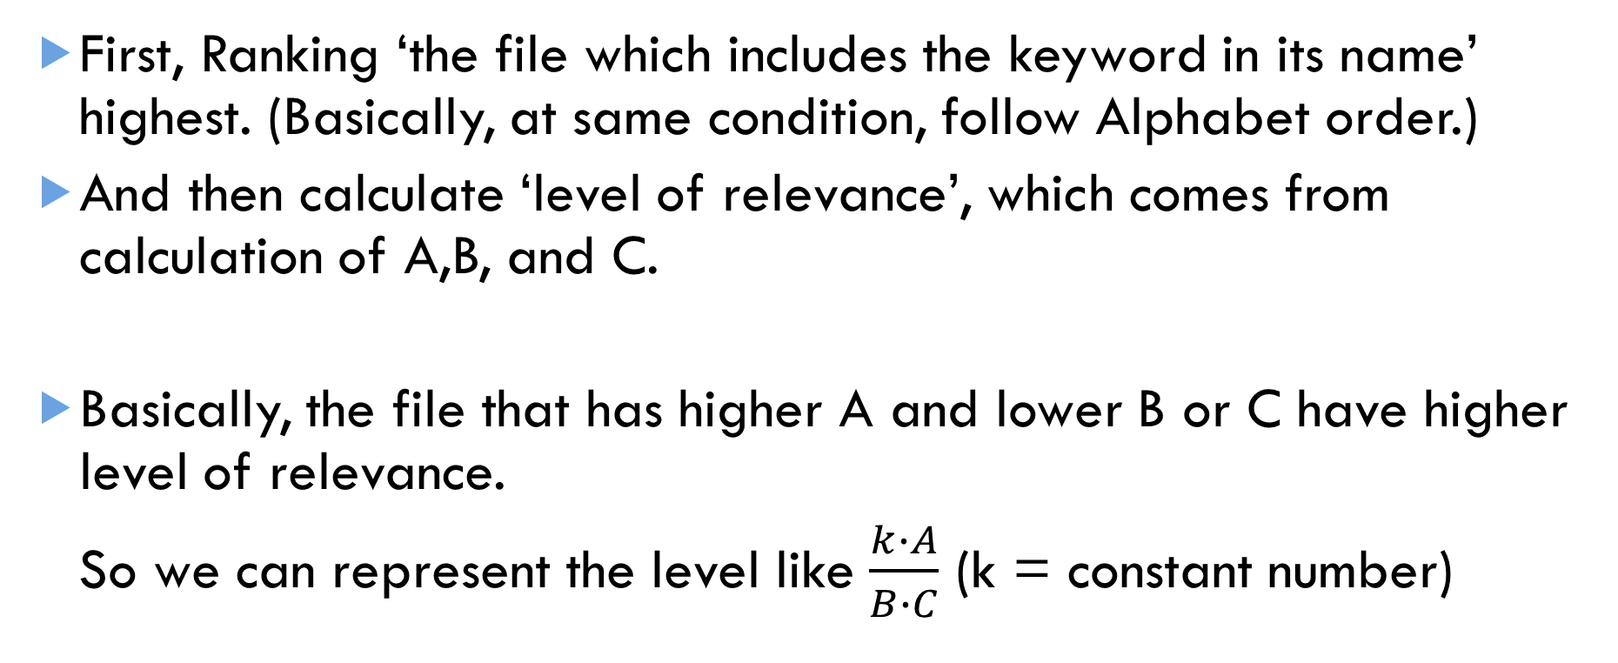
Modeling
First, Ranking ‘the file which includes the keyword in its name’ highest. (Basically, at same condition, follow Alphabet order.)
And then calculate ‘level of relevance’, which comes from calculation of A,B, and C.
Basically, the file that has higher A and lower B or C have higher level of relevance.
So we can represent the level like $\frac{k∙A}{B∙C}$ (k = constant number)

Slide 6
Next time…..
Maybe I can use strstr() function or memchr() in <string.h> which can search keyword in ‘the string’.
And maybe I can use basename() to get the file’s name.

